Slide 1
Azure Load Balancing Services
OCC Engineering team
Srichand Jakka

Slide 2
Agenda
1
Azure Load Balancer
2
Application Gateway
3
Traffic Manager
4
Front Door
5
Q&A

Slide 3
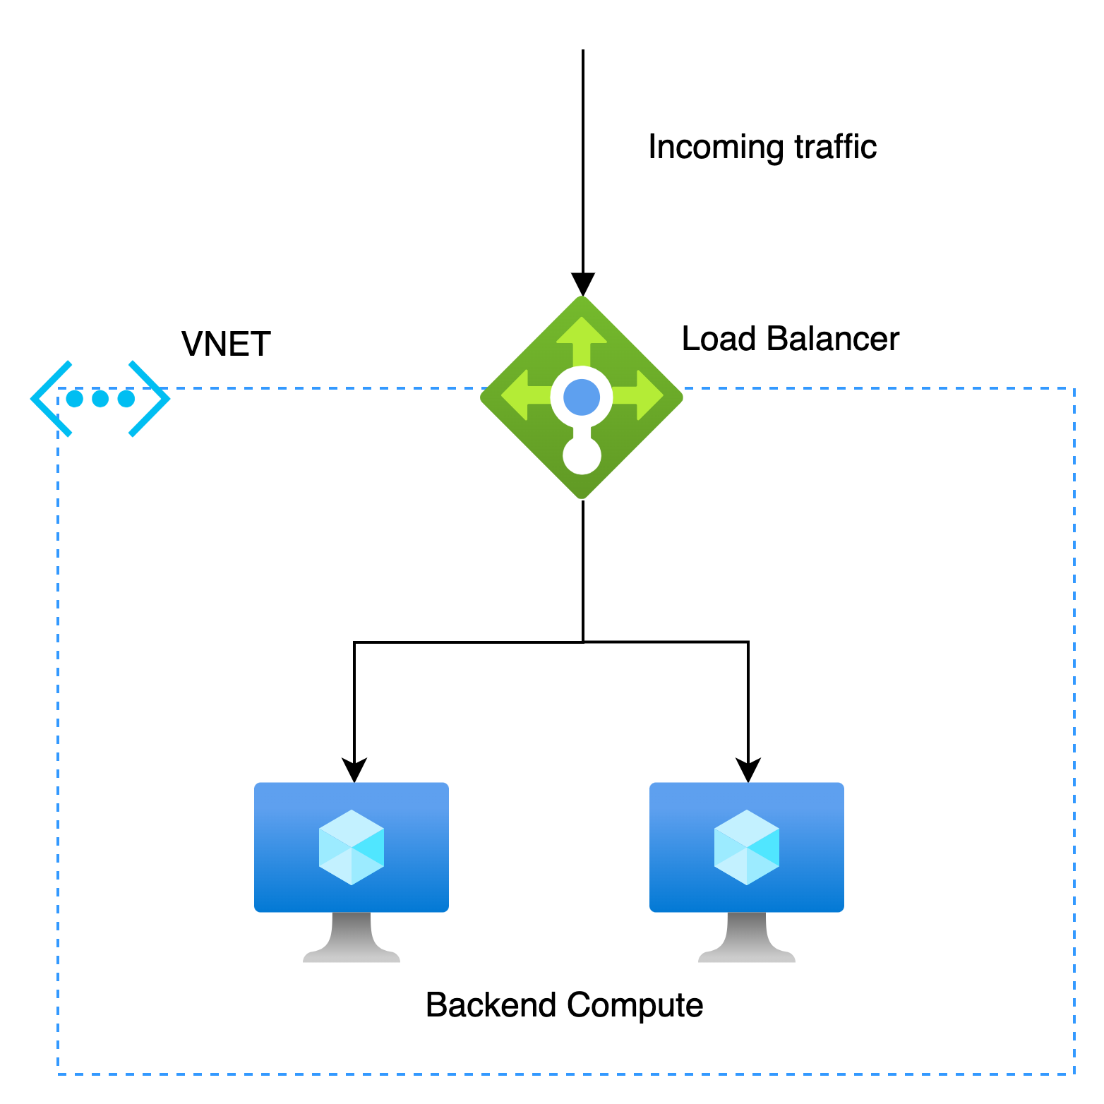
Azure Load Balancer (LB)
Networking solution for distributing the traffic between the backend compute
Layer 4 load balancing (TCP/UDP)
High availability
Backend resources must be redundant
Supports Virtual machines and VM Scale Sets
Public Load balancer
To load balance internet traffic to the backend compute
Maps the PIP and port number of private IP of the backend VMs
Internal Load balancer
Directs traffic to resources within a Virtual Network
No Internet/Public endpoint required
Access the LB via a private IP address

Slide 4




LB Components
Frontend IP
Backend Pool
Health Probe
Rules
Public or private end point
Supports multiple front-end IPs
Group of VMs or instances in VM scale sets to process the incoming request
To check the health status of the backend VMs
https or https custom probe
TCP custom probe
Defines how traffic is distributed to the backend pool
Managed using 5-tuple hash
Session affinity

Slide 5
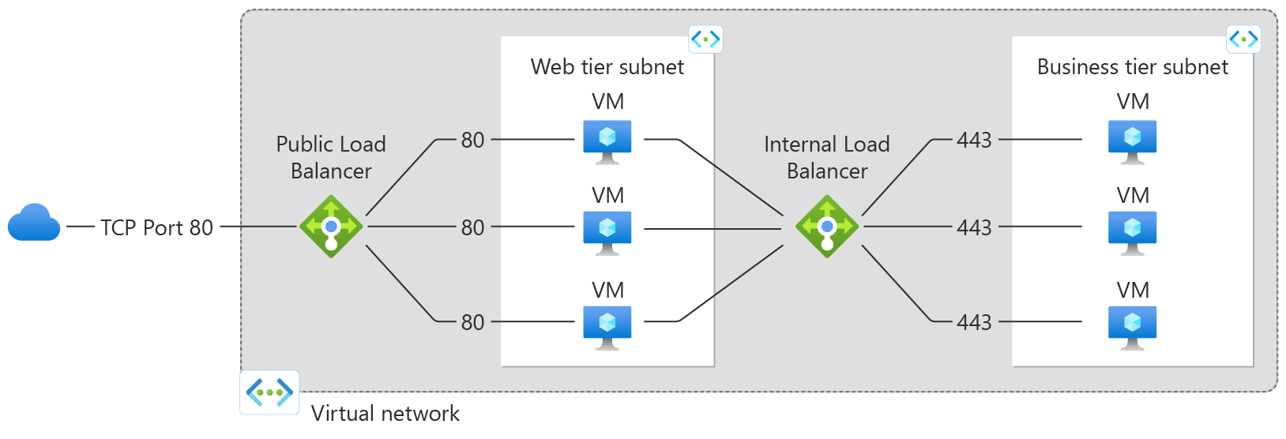
LB – Multi-Tier Application

Slide 6
LB SKU’s
Feature | Basic SKU | Standard SKU
Back-end Pool | Supports up to 300 Instances | Supports up to 1000 Instances
Health Probes | HTTP, TCP | HTTPS, HTTP, TCP
Availability Zones | Not Supported | Supported
Security | NSG is Optional | NSG is required

Slide 7
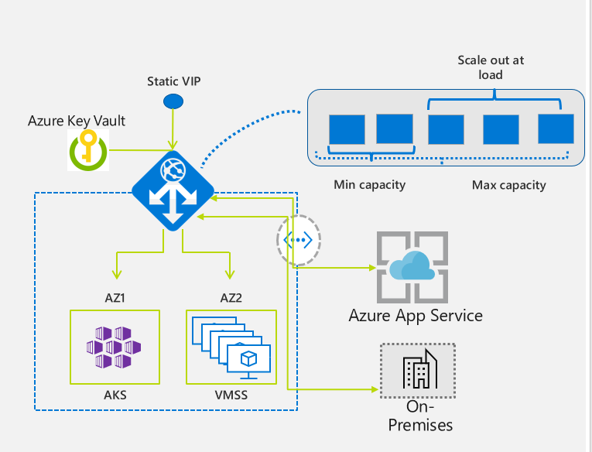
Application Gateway (App GW)
Layer 7 load balancing solution (HTTP/HTTPS)
URL path-based routing
Supports Virtual machines, VM Scale Sets and App Service
Autoscaling
Multi-site hosting
Web Application Firewall (WAF)
End-to-end SSL encryption
SSL offloading

Slide 8

App GW Components
Frontend IP
Listeners
Health Probe
Routing Rules
Client requests are received through the Frontend IP
More than one public IP and one private IP address is not allowed
One or more listeners to receive incoming requests
Basic listener
Multi-site listener
To check which servers are available for load-balancing
Status code 200-399 means backend server is healthy
Binds a listener to the back-end pools
Interpret the URL path and redirects the requests to the appropriate back-end pool

Slide 9
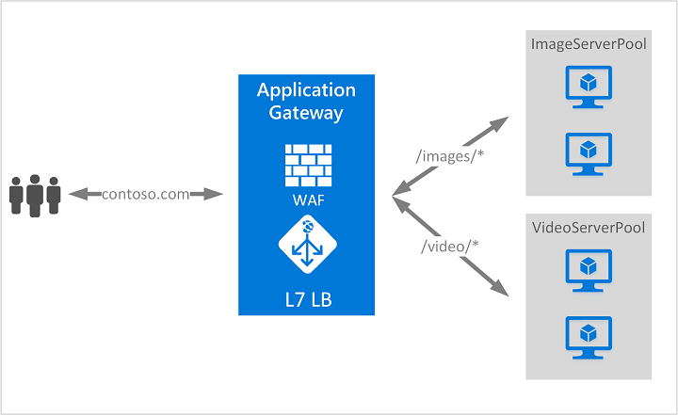
Path-based Routing

Slide 10
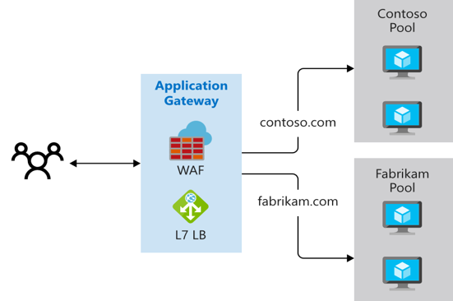
Multiple site Routing

Slide 11
Traffic Manager
DNS-based Global load balancer
Distributes traffic across the global Azure regions
Multiple traffic-routing methods
Endpoint monitoring
Operates at OSI layer 7
Support different endpoints – Azure, External

Slide 12



Traffic Manager Routing Methods
Priority
Weighted
Performance
Geographic
Select Priority routing to use primary service endpoint for all traffic
In case primary endpoint is unavailable, route it to the backup endpoint
To distribute traffic across a set of endpoints based on their weight
Endpoints are in different geographical locations
Use this routing method, when end users to use the "closest" endpoint for the lowest network latency
To direct users to specific endpoints based on where the end users DNS queries originate from geographically

Slide 13
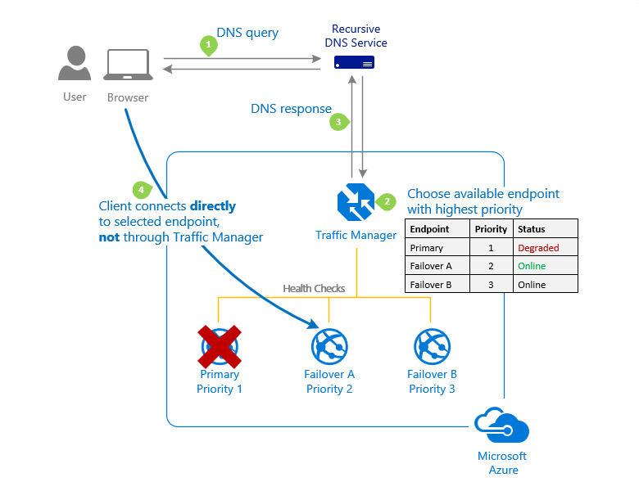
Priority Traffic-routing Method

Slide 14
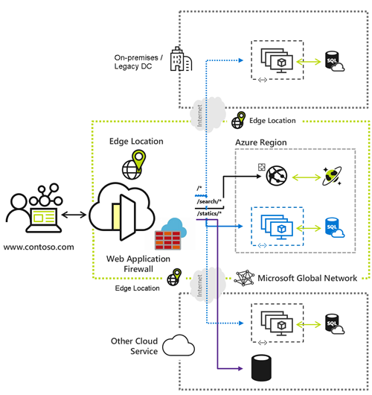
Azure Front Door
Modern cloud content delivery network (CDN) service performance
Provides high availability and acceleration across the globe
Delivers better performance and user experiences for applications/content
Uses Microsoft’s global edge network
Supports Azure endpoints and on-premises

Slide 15
Azure Load Balancing Services
Service | Global/Regional | Recommended Traffic
Azure Front Door | Global | HTTP(S)
Traffic Manager | Global | Non-HTTP(S)
Application Gateway | Regional | HTTP(S)
Azure Load Balancer | Regional | Non-HTTP(S)

Slide 16
DEMO

Slide 17
Q&A

